Slide 1
"Effects of various machining parameters on surface roughness in Turning process"
Project by :
Naveen Pareek
200103082
n.pareek@iitg.ac.in
Madduri Nitham
180103041
nitham@iitg.ac.in
Notes:
We designed this template so that each member of the project team has a set of slides with its own theme. Members, here’s how you add a new slide to just your set:
Mark where you want to add the slide: Select an existing one in the Thumbnails pane, click the New Slide button, then choose a layout. The new slide gets the same theme as the other slides in your set.
Careful! Don’t annoy your fellow presenters by accidentally changing their themes. That can happen if you choose a different theme from the Design tab, which changes all of the slides in the presentation to that look.

Slide 2
Introduction
Turning is the most common lathe machining operation. During the turning process, a cutting tool removes material from the outer diameter of a rotating workpiece. The main objective of turning is to reduce the workpiece diameter to the desired dimension. There are two types of turning operations, rough and finish.
Turning operation is done on turning machine commonly known as lathe machine, which is also of two type : Conventional and CNC Lathe.
Roughness : Surface roughness/roughness is defined as the irregularities which are inherent in the production process.(e.g., cutting tool or abrasive grit). Roughness It is quantified by the deviations in the direction of the normal vector of a real surface from its ideal form. If these deviations are large, the surface is rough; if they are small, the surface is smooth.
While performing every machining operation, we always desire a smooth finish product. So, it always become necessary to find and analyse the factors on which surface roughness depends. This project is also same as to determine and analyse these factors, by changing machine porameters and analysing surface roughness.

Slide 3
Project Description
Surface roughness is an important criteria of the product quality in the machining operations. It depends on cutting parameters of machining. The objective of this research is to investigate experimentally the influence of cutting parameters on the surface roughness in turning operation, in order to determine the optimal settings of these parameters to improve surface roughness in the turning operations.
In this work, surface roughness was measured for steel turned components, which was carried out on a conventional machine with HSS tool at different cutting parameters such as; cutting speed, depth of cut, feed. The experimental results were collected and analyzed. The relation between cutting parameter and surface roughness were determined. The experimental results show that the turned component surface roughness is significantly influenced by the cutting parameters, and the machine tools. The results obtained from this work show that the surface roughness of the turned components decreased by increasing spindle speed and it increased by increasing depth of cut and feed.

Slide 4
Importance of Surface Roughness in machining
Surface roughness is affected by many factors in machining process. Machined components during their useful life are significantly influenced by surface roughness which affects several properties such as; corrosion resistance and fatigue strength, wear resistance, coefficient of friction, ability of distributing and holding a lubricant, load bearing capacity, heat transmission, and coating. Therefore, control of the machined surface roughness is essential, and appropriate processes parameters have to be selected to reach the desired surface quality machined parts. Surface roughness is measured by the vertical deviations of a real surface from its horizontal ideal form. If these deviations are relatively large, the surface is rough; if they are relatively small, the surface is smooth.

Slide 5
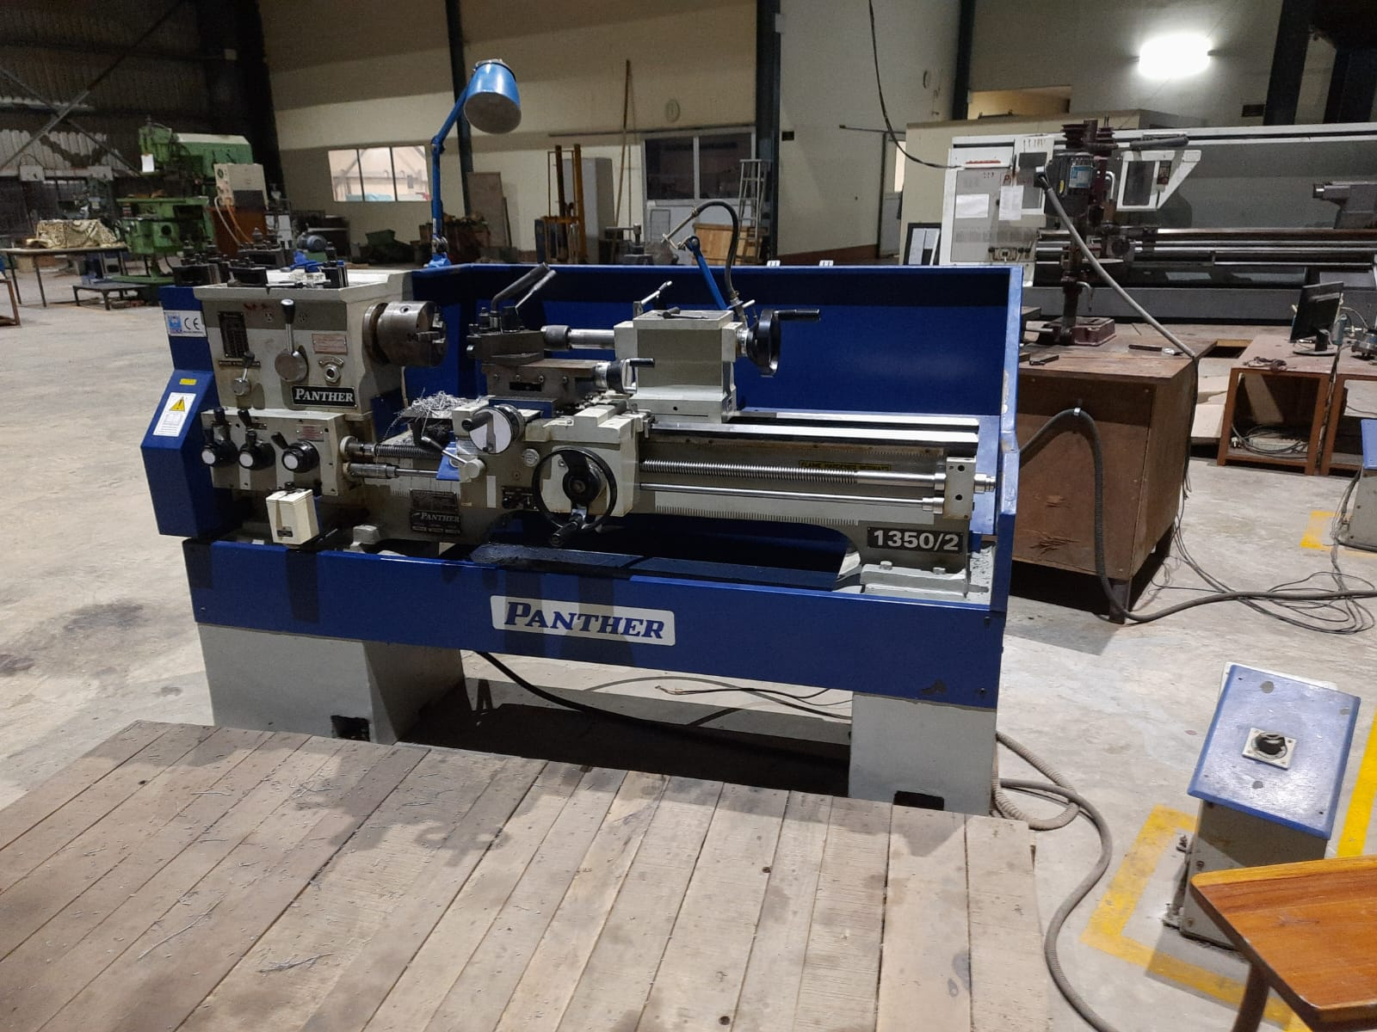
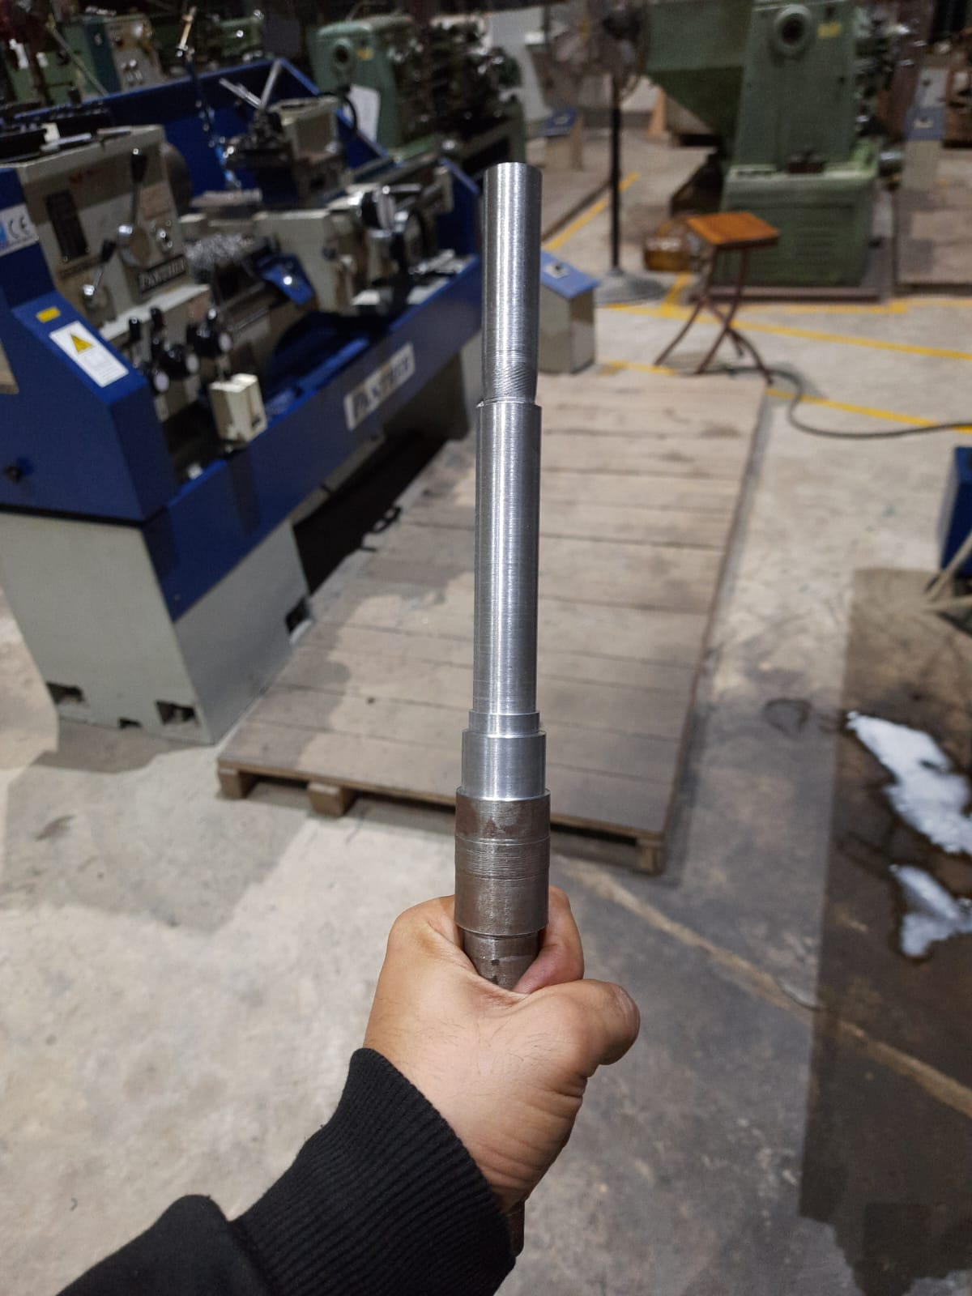
Project Apparatus
1. Engine lathe machine
An engine lathe (Model name: Panther 1350/2) is used in this experiment as a means to perform the turning operation. The chuck with three or four jaws serves to grasp the cylindrical workpiece on its outside diameter. The cutting tool is held in a tool post fastened to the cross-slide, which is assembled to the carriage. The carriage is designed to slide along the ways of the lathe in order to feed the tool parallel to the axis of rotation.
2. workpiece
Workpiece is the metal piece on which machining work is performed. Mild steel rod of cylindrical shape is selected as the work piece for the experiment. The Mild steel work material is selected because of its cheap cost and also because it has wide application in the field of manufacturing.

Slide 6
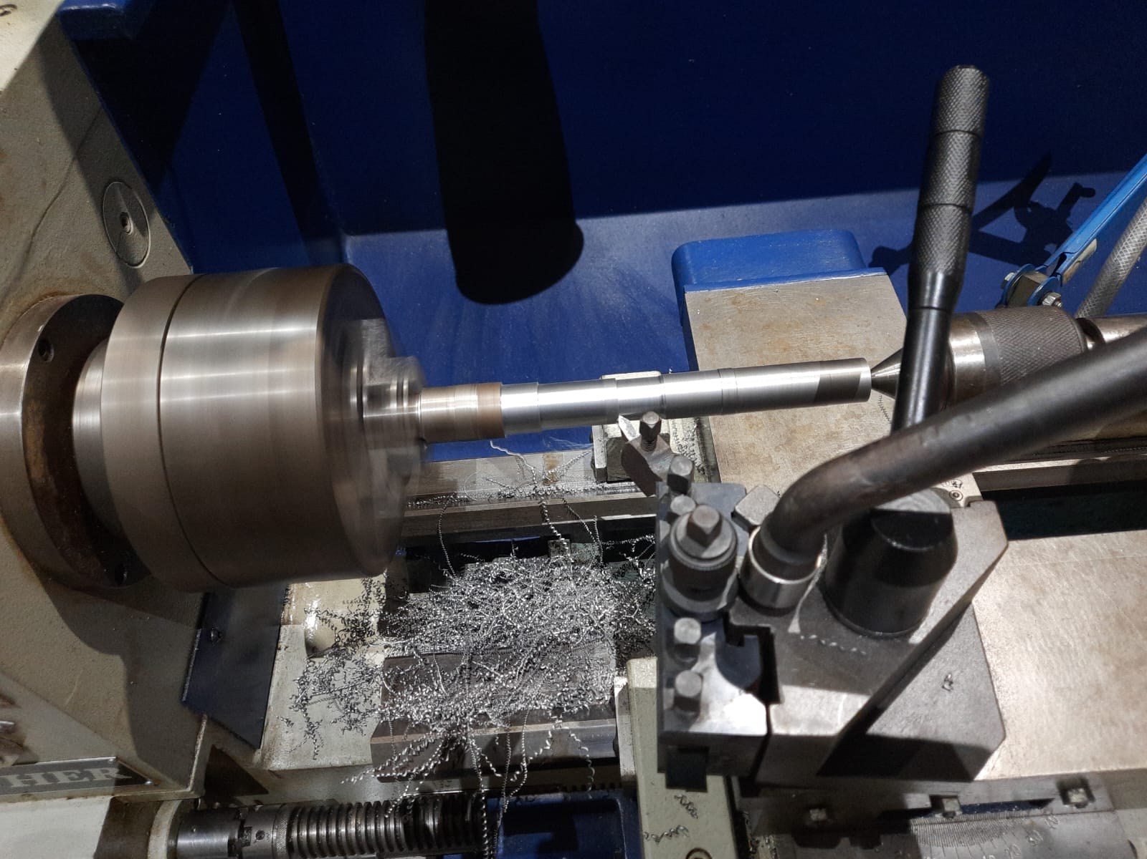

Project Apparatus(Continued.)
3. Cutting tool
The tool used in this experiment is a right hand, single point cutting tool made of high strength steel. Before starting the operation, the tool was sharpened on a grinding wheel to ensure we get consistent results for the whole experiment.
4. Roughness Gauge
The Mahr Pocket Surf IV portable surface roughness gauge/profilometer is used for making traceable, contact surface roughness measurement. A stylus tip makes direct contact with the surface of a sample. The detector tip is equipped with a stylus tip, which traces the surface of the sample and electrically detects the vertical motion of the stylus, giving the value of Rt and Rm for the surface.

Slide 7
Procedure/Methodology
firstly, select a workpiece which easy to machine, and measure its dimensions like, length, diameter.
Then fit this workpiece on the tool holder of lathe machine.
The chuck on the lathe being a self-centering one there was no need to perform the centering manually.
The parameters considered are feed rate, depth of cut and speed of rotation in rpm.
The feed values are adjusted by changing the gears, Rpm can also be varied by changing the gears, and Depth of cut is adjusted by using cross slide.
Then Start turning operation by fixing feed and depth of cut.
Now vary spindle speed and measure roughness of product for every spindle speed.
Repeat whole procedure after fixing depth of cut and spindle speed and measure roughness.
Repeat whole process again after fixing spindle speed and Rpm of machine and varying depth of cut.
Analyse and discuss the result.

Slide 8
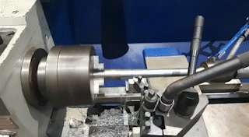
Turning Operation Video

Slide 9
Spindle Speed v/s Roughness

Slide 10
Experimental Observation
In the first set of experiments the cutting speed were changed to the magnitude of (290, 385 and 600 rpm) while feed was fixed at (0.075 mm/rev.) and the depth of cut at (1mm).
​ S No. | ​Spindle Speed (RPM) | ​ Feed Rate (mm/Rev) | ​ Depth (mm) | ​ Roughness (Rmax.) | ​
​ 1. | ​ 290 | ​ 0.075 | ​ 1 | ​ 4.22 | ​
​ 2. | ​ 385 | ​ 0.075 | ​ 1 | ​ 2.53 | ​
​ 3. | ​ 600 | ​ 0.075 | ​ 1 | ​ 1.27 | ​

Slide 11
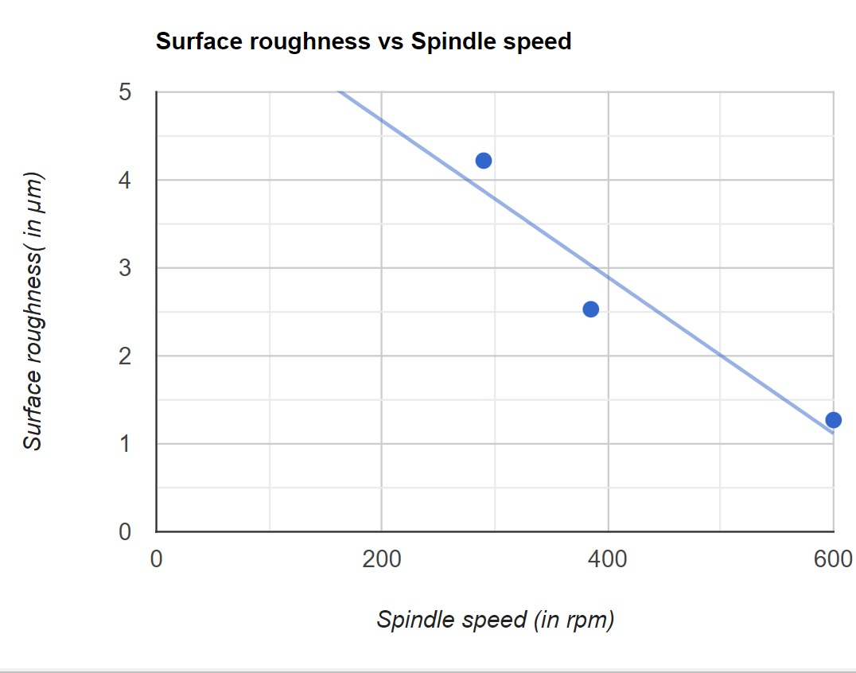
Graph
Graph shows that surface roughness of the finished workpiece decreases with increase in spindle speed, while other parameters are fixed.

Slide 12
Depth of cut verses Roughness

Slide 13
Experimental Observation
The second set of experiments the depth of cut were changed to the magnitude of (0.5, 1 and 1.5 mm) while cutting speed was fixed at (385 r.p.m.) and the feed at (0.075 mm/rev.)
​ S No. | ​Spindle Speed (RPM) | ​ Feed Rate (mm/Rev) | ​ Depth (mm) | ​ Roughness (Rmax.) | ​
​ 1. | ​ 385 | ​ 0.075 | ​ 0.5 | ​ 1.07 | ​
​ 2. | ​ 385 | ​ 0.075 | ​ 1 | ​ 2.53 | ​
​ 3. | ​ 385 | ​ 0.075 | ​ 1.5 | ​ 3.16 | ​

Slide 14
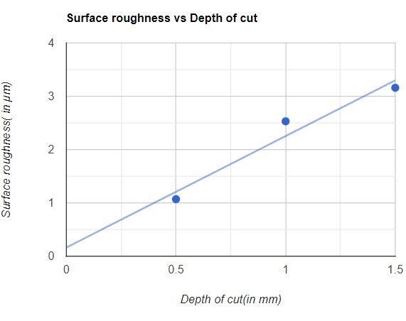
Graph
Graph shows that surface roughness of the finished workpiece increases with increase in depth of cut, while other parameters are fixed.

Slide 15
Feed rate v/s Roughness

Slide 16
Experimental observations
In the third set of experiments the feed were changed to the magnitude of (0.05, 0.075 and 0.1 mm/rev.) while cutting speed was fixed at (385 r.p.m.) and the depth of cut was (1mm).
​ S No. | ​Spindle Speed (RPM) | ​ Feed Rate (mm/Rev) | ​ Depth (mm) | ​ Roughness (Rmax.) | ​
​ 1. | ​ 385 | ​ 0.05 | ​ 1 | ​ 0.7 | ​
​ 2. | ​ 385 | ​ 0.075 | ​ 1 | ​ 1.07 | ​
​ 3. | ​ 385 | ​ 0.1 | ​ 1 | ​ 2.80 | ​

Slide 17
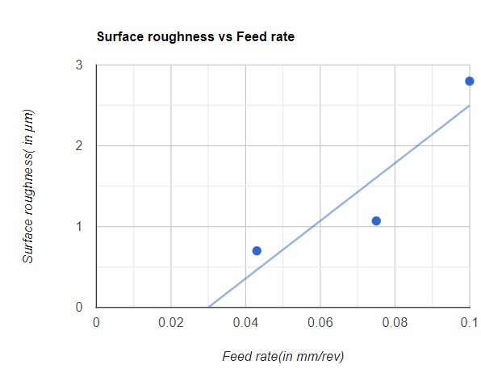
Graph
Graph shows that surface roughness of the finished workpiece increases with increase in feed, while other parameters are fixed.

Slide 18
Project Summary

Slide 19
Results and Discussion
Surface roughness was measured for the turned component at different cutting parameters by changing one parameter and fixing the others to determine the effect of each parameter on the surface roughness.
​
The results of the surface roughness represents the relation between the surface roughness and cutting speed, where all other parameters were remained constant in order to get only the effect of cutting speed on the surface roughness. It is clear that surface roughness decreased by increasing cutting speed. This attributed is due to the decrease in the built-up edge size at higher speed where the influence of the built-up edge became negligible. In addition, the cutting process becomes more and more stable as the speed increases, and the vibration during cutting at the highest speed is lower.​
The relation between the surface roughness and depth of cut where, cutting speed and feed and all of the other parameters were remained constant. It is clear that surface roughness is increased by increasing depth of cut.

Slide 20
Results and Discussion
It is due to the increase in machine tool vibration which increases due to the increase in the cutting force, which increases by increasing the depth of cut, and also due built-up edge formation represents the relation between the surface roughness and feed, where all other parameters were remained constant. It is clear that surface roughness is decreased by increasing the feed.
The relation between the surface roughness and feed rate or feed where, cutting speed and feed and all of the other parameters were remained constant. It is clear that surface roughness is increased by increasing feed rate. It is due to the increase in machine tool vibration which increases due to the increase in the cutting force, which increases by increasing the feed.
To improve machining productivity by increasing feed and depth of cut will be against achieving better surface quality. However, it is obviously that increasing the feed significantly influences the surface roughness than increasing the depth of cut. Thus, is it recommended to increase the depth of cut more than feed to improve the machining productivity.

Slide 21
Conclusion
In this work, steel specimens were machined out on conventional turning machines at different cutting parameters. Surface roughness was measured for all of the machined specimens.
The conclusions drawn from the above experiments are summarized as follows:
1. By increasing spindle speed, surface roughness decreased.
2. As the depth of cut increased, the Surface roughness increased.
3. Surface roughness increased by increasing too feed.
4. The feed had highest effect on surface roughness than depth of cut.
Also, I got knowledge that :
1. machined surface roughness is less on the CNC turning machine than on the conventional machine.
2. Type of tool and tool angle can also vary roughness.
3. a finished and grinded tool give better surface finish.

Slide 22
Acknowledgement
We would like to thank Dr. Biranchi Panda, our Professor of Manufacturing technology(II), for their support and guidance in completing our project on the topic (Effects of various machining parameters on surface roughness in Turning process). It was a great learning experience.
I would like to take this opportunity to express my gratitude to all of my friends and instructors who helped us directly or indirectly. The project would not have been successful without their cooperation and inputs.

Slide 23
References
Study material provided in class.
EFFECT OF CUTTING PARAMETERS ON SURFACE ROUGHNESS IN TURNING OPERATIONS by Khalid Ahmed Al-Dolaimy, Al-Qadisiyah Journal For Engineering Sciences
Thank You

